Slide 1

Lecture #1

Slide 2
Operating system by Tahmina Asghar
Lecture # 1

Slide 3
Marks Distribution
Internal Assessment: 35 Marks
Mid Semester Examination: 25 Marks
Final Semester Examination: 40 Marks

Slide 4
Rules to Remember
Come to class prepared to learn.
Keep your mobiles Silent and keep it inside your bag.
Late arrival in my class will be marked Absent
Raise your hand before speaking or leaving your seat.
Listen and follow directions.
Actively participate in classroom activities
Ask Questions.
Convey your issue to your instructor through your CR.

Slide 5
Rules for Assignments
No extensions will be granted for submission of assignments.
Once deadline is over, no assignment will be accepted.
Plagiarism will be checked for each assignment (Where Applicable).

Slide 6
Operating System
Introduction

Slide 7
Overview
A computer system has many resources (hardware and software), which may be require to complete a task.
The commonly required resources are input/output devices, memory, file storage space, CPU etc.
Software also plays a vital role in a computer system
Application Software
System Software

Slide 8
What is Operating System?
A program that acts as an intermediary between a user of a computer and the computer hardware
An operating system (OS) is essential system software that manages computer hardware and software resources, serving as an intermediary between users and the computer. It handles crucial tasks like process management, memory allocation, input/output control, and file management, enabling applications to run efficiently. Common examples include Android, Microsoft Windows, iOS, and macOS.
Without an operating system, a computer would not be able to function, as it acts as the foundation for all application software.

Slide 9
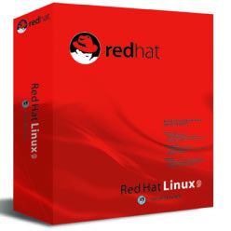
Operating System
In technical terms, operating system is the resource manager i.e. it can manage the resource of a computer system internally.
The resources are; processor, memory, storage, I/O Devices, files etc.

Slide 10
Computer-System Organization
A modern computer system consists of one or more CPUs and multiple device controllers, all connected via a common bus to shared memory. Each device controller manages a specific type of device (e.g., disk drives, audio, video). The CPU and controllers operate in parallel, with a memory controller ensuring synchronized access.
When powered on or rebooted, the system runs a bootstrap program stored in ROM or EEPROM (firmware). This program initializes the system, sets up hardware components, and loads the operating system for execution. For completing this goal, the bootstrap program must locate the operating-system kernel and load it into memory.

Slide 11
Explanation
A computer system is like a team where everyone has a specific job:
CPU (Brain): The CPU is like the manager. It makes decisions and tells others what to do.
Device Controllers (Helpers): Each device (keyboard, mouse, hard disk, speakers, screen) has its own helper called a controller. For example:
Disk controller → handles hard disk
Audio controller → handles sound
Video controller → handles display

Slide 12
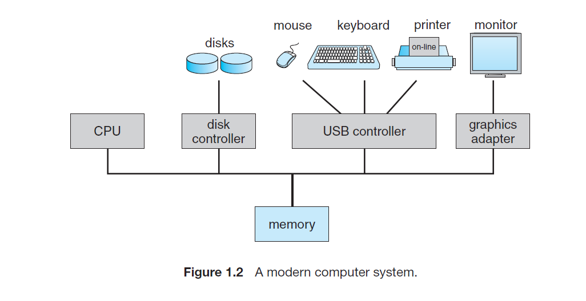

Slide 13
Storage Structure
The CPU is the brain of the computer.
The CPU can only work with instructions that are in RAM (main memory).
RAM (DRAM) is fast and used for daily work.
Programs like Word, browser, etc., are stored in rewritable memory so they can be changed.

Slide 14
ROM and EEPROM (Why They Are Different)
ROM / EEPROM store fixed programs that do not change often.
The c++ program is stored here.
This program helps the computer start up and load the operating system.
Memory and Addresses (Very Simple)
Memory is made of small boxes called bytes.
Each box has a unique address, like house numbers on a street.
The CPU uses these addresses to find exact data.

Slide 15
A computer executes instructions by fetching, decoding, and executing them, then storing the results in memory. Main memory (RAM) is fast but limited and loses data when power is off, so secondary storage like disks is used for permanent storage. Different storage types (registers, cache, RAM, disks, CDs) vary in speed, size, cost, and volatility, and efficient storage management improves system performance.

Slide 16
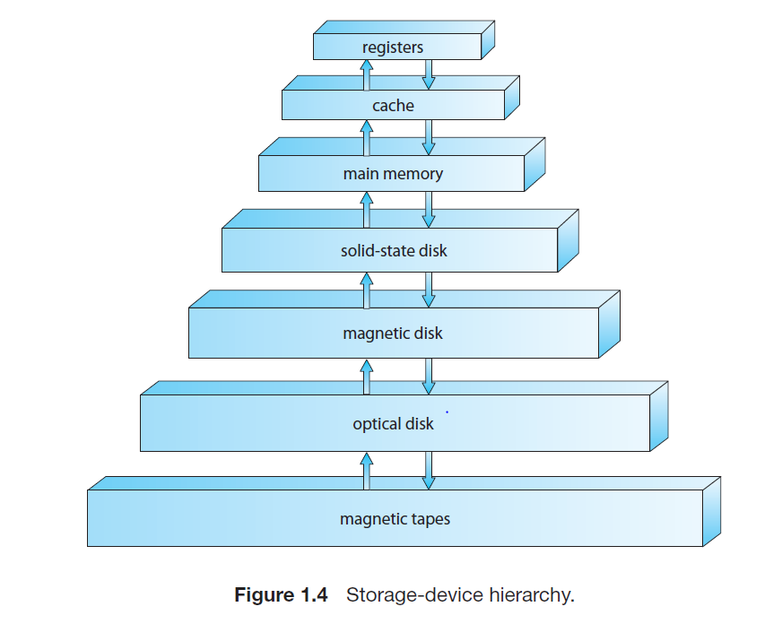

Slide 17
I/O Structure
In a computer, input/output (I/O) devices like keyboards, printers, and disks are managed using device controllers and device drivers. A device controller directly controls a specific device and temporarily stores data in its own buffer, while a device driver is software that helps the operating system communicate with the device in a standard and easy way.
For I/O operations, the driver sets up the controller, which performs the data transfer. The controller signals completion via an interrupt. For large data transfers, Direct Memory Access (DMA) allows controllers to transfer entire blocks of data directly to or from memory with minimal CPU involvement, reducing overhead and improving efficiency.

Slide 18
How the System Works:
When you click Print, the CPU asks the device driver to handle the task. The driver sets up the printer controller and gives it instructions. The controller starts printing and transfers data. When printing is finished, the printer sends a signal called an interrupt to tell the CPU, “I’m done!”
For a large document, the system uses DMA (Direct Memory Access). DMA allows the printer controller to take the whole document directly from main memory (RAM) without bothering the CPU for every page. This makes printing faster and lets the CPU do other work at the same time.

Slide 19
Two Views of Operating System
User's View
System View

Slide 20
Operating System: User View
The user view of the computer refers to the interface being used.
Such systems are designed for one user to monopolize its resources, to maximize the work that the user is performing.
In these cases, the operating system is designed mostly for ease of use, with some attention paid to performance, and none paid to resource utilization.

Slide 21
Operating System: System View
Operating system can be viewed as a resource allocator also.
A computer system consists of many resources like - hardware and software - that must be managed efficiently.
The operating system acts as the manager of the resources, decides between conflicting requests, controls execution of programs etc.

Slide 22
What Operating Systems Do
Depends on the point of view
Users want convenience, ease of use and good performance
Don’t care about resource utilization
But shared computer such as mainframe or minicomputer must keep all users happy
Users of dedicate systems such as workstations have dedicated resources but frequently use shared resources from servers
Handheld computers are resource poor, optimized for usability and battery life
Some computers have little or no user interface, such as embedded computers in devices and automobiles

